Slide 1
Main Memory

Slide 2
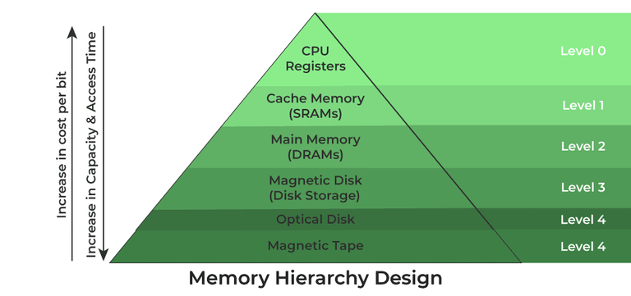
Memory Hierarchy

Slide 3
Contd…
Program must be brought (from disk) into memory and placed within a process for it to be run
Main memory and registers are only storage CPU can access directly
Memory unit only sees a stream of addresses + read requests, or address + data and write requests
Register access in one CPU clock (or less)
Main memory can take many cycles, causing a stall
Cache sits between main memory and CPU registers
Protection of memory required to ensure correct operation

Slide 4
Memory and Programs
Programs need memory to store instructions and data
Memory locations are identified using addresses
Modern computers run many programs at the same time

Slide 5
Physical Memory (RAM)
RAM is a hardware device
RAM has real memory locations
These locations are called physical addresses
Example:
1000, 1001, 1002

Slide 6
Problem with Using Physical Addresses
All programs share the same RAM
Direct use causes crashes and data overwrite
No protection between programs

Slide 7
Logical Address – Program View
Each program is given its own memory numbers
These numbers are private to the program
Program A: 0,1,2...
Program B: 0,1,2...

Slide 8
Logical Address – Definition
Address generated and used by a program
Not a real RAM address
Meaningful only inside that program

Slide 9
Logical vs Physical Address
Logical Address:
Used by program
Program-specific
Physical Address:
Used by RAM
Real memory location

Slide 10
Logical Address in C Program
int a = 10;
printf("%p", &a);
Printed address is a logical address
Changes every run

Slide 11
Address Translation
Logical Address → Operating System → Physical Address

Slide 12
Limited RAM Problem
RAM size is limited
Programs may need more memory than RAM
Example:
RAM = 8GB
Program = 12GB

Slide 13
What is Virtual Memory?
Allows programs to use more memory than RAM
Provides illusion of large memory

Slide 14
Virtual Memory – View
Program thinks it has large memory
Only required parts are kept in RAM

Slide 15
Virtual Memory & Logical Address
Virtual memory is based on logical addresses
Logical address space = Virtual address space

Slide 16
Virtual Memory Example
while(1) {
malloc(1024*1024);
}
Program doesn’t crash immediately

Slide 17
Advantages of Virtual Memory
Programs can be larger than RAM
Better memory utilization
More programs can run

Slide 18
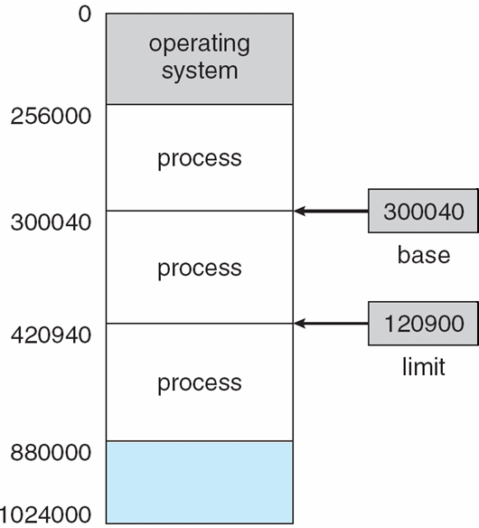
Base and Limit Registers
A pair of base and limit registers define the logical address space
CPU must check every memory access generated in user mode to be sure it is between base and limit for that user

Slide 19
Hardware Address Protection

Slide 20
Address Binding
Programs on disk, ready to be brought into memory to execute form an input queue
Without support, must be loaded into address 0000
Inconvenient to have first user process physical address always at 0000
How can it not be?
Further, addresses represented in different ways at different stages of a program’s life
Source code addresses usually symbolic
Compiled code addresses bind to relocatable addresses
i.e. “14 bytes from beginning of this module”
Linker or loader will bind relocatable addresses to absolute addresses
i.e. 74014
Each binding maps one address space to another

Slide 21
Binding of Instructions and Data to Memory
Address binding of instructions and data to memory addresses can happen at three different stages
Compile time: If memory location known a priori, absolute code can be generated; must recompile code if starting location changes
Load time: Must generate relocatable code if memory location is not known at compile time
Execution time: Binding delayed until run time if the process can be moved during its execution from one memory segment to another
Need hardware support for address maps (e.g., base and limit registers)

Slide 22

Multistep Processing of a User Program

Slide 23
Logical vs. Physical Address Space
The concept of a logical address space that is bound to a separate physical address space is central to proper memory management
Logical address – generated by the CPU; also referred to as virtual address
Physical address – address seen by the memory unit
Logical and physical addresses are the same in compile-time and load-time address-binding schemes; logical (virtual) and physical addresses differ in execution-time address-binding scheme
Logical address space is the set of all logical addresses generated by a program
Physical address space is the set of all physical addresses generated by a program

Slide 24
Case 1: Compile-Time Address Binding
Logical and physical addresses are the same.
The compiler hardcodes absolute addresses in the code.
The program must always load at the same physical location.
Example
Logical Address → 1000, 1004, 1008
Physical Address → 1000, 1004, 1008

Slide 25
Case 2: Load-Time Address Binding
Logical addresses start from 0.
The OS assigns a base physical address when loading the program.
Logical addresses are converted once into physical addresses.
Example
Logical Address → 0, 4, 8
Physical Address → (Base Address) + Logical Address
If Base Address = 5000, then
Physical Address → 5000, 5004, 5008

Slide 26
Case 3: Execution-Time Address Binding (With MMU)
Logical addresses start from 0.
The Memory Management Unit (MMU) translates logical addresses to physical addresses dynamically.
The process can move in memory.
Example
Logical Address → 0, 4, 8
MMU Mapping:
Logical 0 → Physical 7000
Logical 4 → Physical 7004
Logical 8 → Physical 7008
(Next time the program runs, it might be at a different location.)

Slide 27
Memory-Management Unit (MMU)
Hardware device that at run time maps virtual to physical address
Many methods possible, covered in the rest of this chapter
To start, consider simple scheme where the value in the relocation register is added to every address generated by a user process at the time it is sent to memory
Base register now called relocation register
MS-DOS on Intel 80x86 used 4 relocation registers
The user program deals with logical addresses; it never sees the real physical addresses
Execution-time binding occurs when reference is made to location in memory
Logical address bound to physical addresses

Slide 28
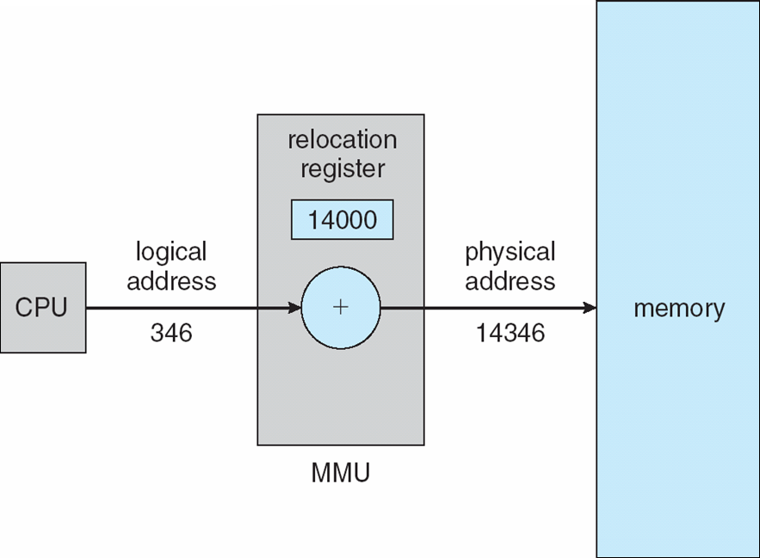
Dynamic relocation using a relocation register
Routine is not loaded until it is called
Better memory-space utilization; unused routine is never loaded
All routines kept on disk in relocatable load format
Useful when large amounts of code are needed to handle infrequently occurring cases
No special support from the operating system is required
Implemented through program design
OS can help by providing libraries to implement dynamic loading

Slide 29
Dynamic Linking
Static linking – system libraries and program code combined by the loader into the binary program image
Dynamic linking –linking postponed until execution time
Small piece of code, stub, used to locate the appropriate memory-resident library routine
Stub replaces itself with the address of the routine, and executes the routine
Operating system checks if routine is in processes’ memory address
If not in address space, add to address space
Dynamic linking is particularly useful for libraries
System also known as shared libraries
Consider applicability to patching system libraries
Versioning may be needed

Slide 30
Swapping
A process can be swapped temporarily out of memory to a backing store, and then brought back into memory for continued execution
Total physical memory space of processes can exceed physical memory
Backing store – fast disk large enough to accommodate copies of all memory images for all users; must provide direct access to these memory images
Roll out, roll in – swapping variant used for priority-based scheduling algorithms; lower-priority process is swapped out so higher-priority process can be loaded and executed
Major part of swap time is transfer time; total transfer time is directly proportional to the amount of memory swapped
System maintains a ready queue of ready-to-run processes which have memory images on disk

Slide 31
Swapping (Cont.)
Does the swapped out process need to swap back in to same physical addresses?
Depends on address binding method
Plus consider pending I/O to / from process memory space
Modified versions of swapping are found on many systems (i.e., UNIX, Linux, and Windows)
Swapping normally disabled
Started if more than threshold amount of memory allocated
Disabled again once memory demand reduced below threshold

Slide 32

Schematic View of Swapping

Slide 33
Context Switch Time including Swapping
If next processes to be put on CPU is not in memory, need to swap out a process and swap in target process
Context switch time can then be very high
100MB process swapping to hard disk with transfer rate of 50MB/sec
Swap out time of 2000 ms
Plus swap in of same sized process
Total context switch swapping component time of 4000ms (4 seconds)
Can reduce if reduce size of memory swapped – by knowing how much memory really being used
System calls to inform OS of memory use via request_memory() and release_memory()

Slide 34
Context Switch Time and Swapping (Cont.)
Other constraints as well on swapping
Pending I/O – can’t swap out as I/O would occur to wrong process
Or always transfer I/O to kernel space, then to I/O device
Known as double buffering, adds overhead
Standard swapping not used in modern operating systems
But modified version common
Swap only when free memory extremely low

Slide 35
Memory Allocation Methods

Slide 36
Contiguous Allocation
Main memory must support both OS and user processes
Limited resource, must allocate efficiently
Contiguous allocation is one early method
Main memory usually into two partitions:
Resident operating system, usually held in low memory with interrupt vector
User processes then held in high memory
Each process contained in single contiguous section of memory

Slide 37
Contiguous Allocation (Cont.)
Relocation registers used to protect user processes from each other, and from changing operating-system code and data
Base register contains value of smallest physical address
Limit register contains range of logical addresses – each logical address must be less than the limit register
MMU maps logical address dynamically
Can then allow actions such as kernel code being transient and kernel changing size

Slide 38

Hardware Support for Relocation and Limit Registers

Slide 39
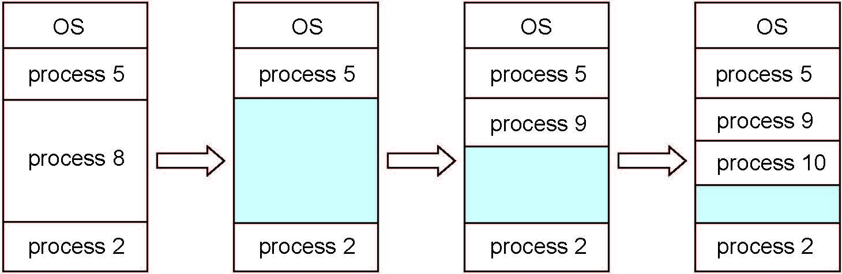
Multiple-partition allocation
Multiple-partition allocation
Degree of multiprogramming limited by number of partitions
Variable-partition sizes for efficiency (sized to a given process’ needs)
Hole – block of available memory; holes of various size are scattered throughout memory
When a process arrives, it is allocated memory from a hole large enough to accommodate it
Process exiting frees its partition, adjacent free partitions combined
Operating system maintains information about: a) allocated partitions b) free partitions (hole)

Slide 40
Dynamic Storage-Allocation Problem
How to satisfy a request of size n from a list of free holes?
First-fit: Allocate the first hole that is big enough
Best-fit: Allocate the smallest hole that is big enough; must search entire list, unless ordered by size
Produces the smallest leftover hole
Worst-fit: Allocate the largest hole; must also search entire list
Produces the largest leftover hole
First-fit and best-fit better than worst-fit in terms of speed and storage utilization

Slide 41
Fragmentation
External Fragmentation – total memory space exists to satisfy a request, but it is not contiguous
Internal Fragmentation – allocated memory may be slightly larger than requested memory; this size difference is memory internal to a partition, but not being used
First fit analysis reveals that given N blocks allocated, 0.5 N blocks lost to fragmentation
1/3 may be unusable -> 50-percent rule

Slide 42
Fragmentation (Cont.)
Reduce external fragmentation by compaction
Shuffle memory contents to place all free memory together in one large block
Compaction is possible only if relocation is dynamic, and is done at execution time
I/O problem
Latch job in memory while it is involved in I/O
Do I/O only into OS buffers
Now consider that backing store has same fragmentation problems

Slide 43
Questions
Memory partitions of 100kb,500 kb,200 kb,300kb,600 kb are available. How would best ,worst, first fit algorithm place processes 212,417,112,426 in order. Which is the best algorithm?
The available space list of a computer memory is specified as follows: Start address block address in words 100 50 200 150 450 600 1200 400 Determine the available space list after allocating the space for the stream of requests consisting of the following block sizes: 25,100,250,200,100,150 Use i) FIRST FIT ii) BEST FIT and iii) WORST FIT algorithms.

Slide 44
Segmentation
Memory-management scheme that supports user view of memory
A program is a collection of segments
A segment is a logical unit such as:
main program
procedure
function
method
object
local variables, global variables
common block
stack
symbol table
arrays

Slide 45
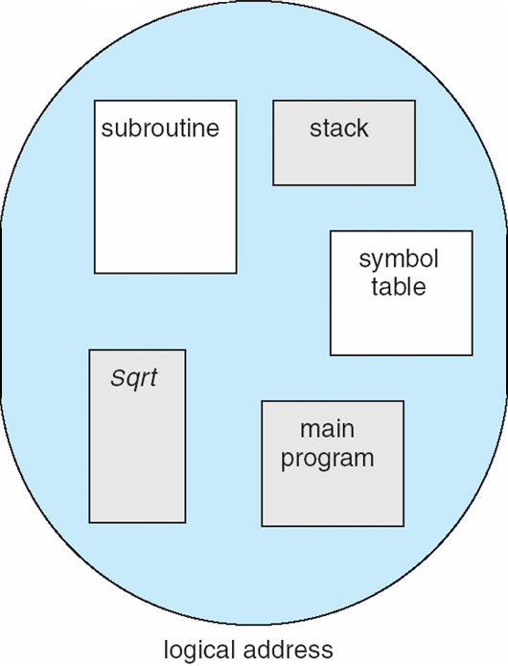
User’s View of a Program

Slide 46
Logical View of Segmentation
1
1
4
2
3
4
2
3
user space
physical memory space

Slide 47
Segmentation Architecture
Logical address consists of a two tuple:
<segment-number, offset>,
Segment table – maps two-dimensional physical addresses; each table entry has:
base – contains the starting physical address where the segments reside in memory
limit – specifies the length of the segment
Segment-table base register (STBR) points to the segment table’s location in memory
Segment-table length register (STLR) indicates number of segments used by a program;
segment number s is legal if s < STLR

Slide 48
Segmentation Architecture (Cont.)
Protection
With each entry in segment table associate:
validation bit = 0 ⇒ illegal segment
read/write/execute privileges
Protection bits associated with segments; code sharing occurs at segment level
Since segments vary in length, memory allocation is a dynamic storage-allocation problem
A segmentation example is shown in the following diagram

Slide 49
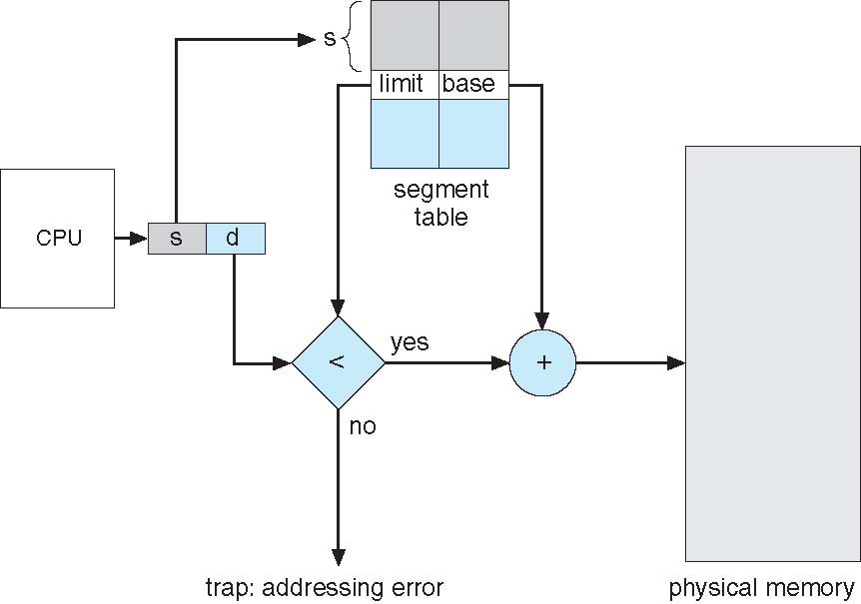
Segmentation Hardware

Slide 50
Paging
Physical address space of a process can be noncontiguous; process is allocated physical memory whenever the latter is available
Avoids external fragmentation
Avoids problem of varying sized memory chunks
Divide physical memory into fixed-sized blocks called frames
Size is power of 2, between 512 bytes and 16 Mbytes
Divide logical memory into blocks of same size called pages
Keep track of all free frames
To run a program of size N pages, need to find N free frames and load program
Set up a page table to translate logical to physical addresses
Backing store likewise split into pages
Still have Internal fragmentation

Slide 51
Address Translation Scheme
Address generated by CPU is divided into:
Page number (p) – used as an index into a page table which contains base address of each page in physical memory
Page offset (d) – combined with base address to define the physical memory address that is sent to the memory unit
For given logical address space 2^{m} and page size 2^{n}

Slide 52
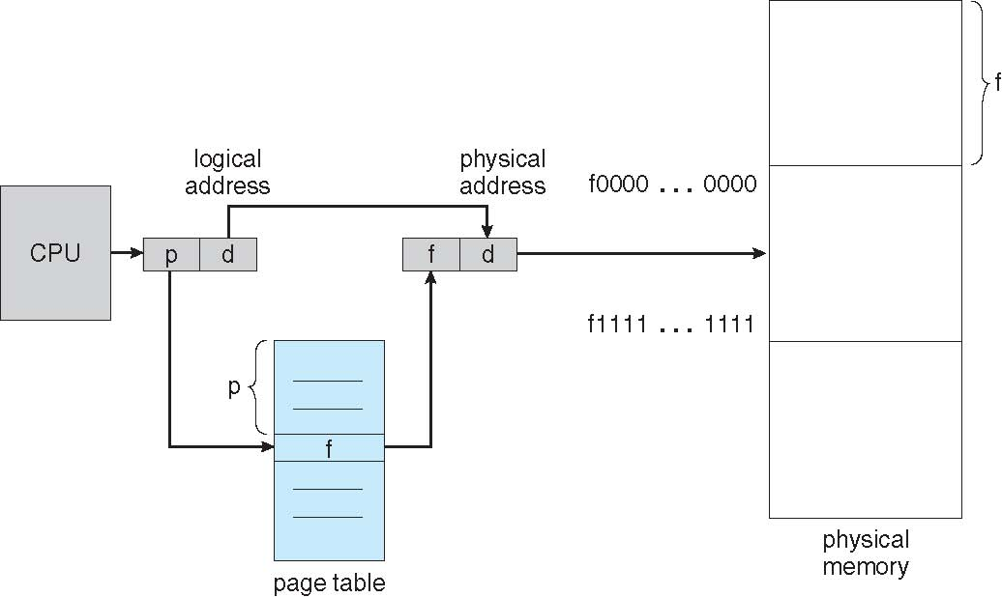
Paging Hardware

Slide 53

Paging Model of Logical and Physical Memory

Slide 54

Paging Example
n=2 and m=4 32-byte memory and 4-byte pages

Slide 55
Paging (Cont.)
Calculating internal fragmentation
Page size = 2,048 bytes
Process size = 72,766 bytes
35 pages + 1,086 bytes
Internal fragmentation of 2,048 - 1,086 = 962 bytes
Worst case fragmentation = 1 frame – 1 byte
On average fragmentation = 1 / 2 frame size
So small frame sizes desirable?
But each page table entry takes memory to track
Page sizes growing over time
Solaris supports two page sizes – 8 KB and 4 MB
Process view and physical memory now very different
By implementation process can only access its own memory

Slide 56

Free Frames
Before allocation
After allocation

Slide 57
Implementation of Page Table
Page table is kept in main memory
Page-table base register (PTBR) points to the page table
Page-table length register (PTLR) indicates size of the page table
In this scheme every data/instruction access requires two memory accesses
One for the page table and one for the data / instruction
The two memory access problem can be solved by the use of a special fast-lookup hardware cache called associative memory or translation look-aside buffers (TLBs)

Slide 58
Implementation of Page Table (Cont.)
Some TLBs store address-space identifiers (ASIDs) in each TLB entry – uniquely identifies each process to provide address-space protection for that process
Otherwise need to flush at every context switch
TLBs typically small (64 to 1,024 entries)
On a TLB miss, value is loaded into the TLB for faster access next time
Replacement policies must be considered
Some entries can be wired down for permanent fast access

Slide 59
Associative Memory
Associative memory – parallel search
Address translation (p, d)
If p is in associative register, get frame # out
Otherwise get frame # from page table in memory

Slide 60

Paging Hardware With TLB

Slide 61
Virtual Memory

Slide 62
Background
Code needs to be in memory to execute, but entire program rarely used
Error code, unusual routines, large data structures
Entire program code not needed at same time
Consider ability to execute partially-loaded program
Program no longer constrained by limits of physical memory
Each program takes less memory while running -> more programs run at the same time
Increased CPU utilization and throughput with no increase in response time or turnaround time
Less I/O needed to load or swap programs into memory -> each user program runs faster

Slide 63
Background (Cont.)
Virtual memory – separation of user logical memory from physical memory
Only part of the program needs to be in memory for execution
Logical address space can therefore be much larger than physical address space
Allows address spaces to be shared by several processes
Allows for more efficient process creation
More programs running concurrently
Less I/O needed to load or swap processes

Slide 64
Background (Cont.)
Virtual address space – logical view of how process is stored in memory
Usually start at address 0, contiguous addresses until end of space
Meanwhile, physical memory organized in page frames
MMU must map logical to physical
Virtual memory can be implemented via:
Demand paging
Demand segmentation

Slide 65
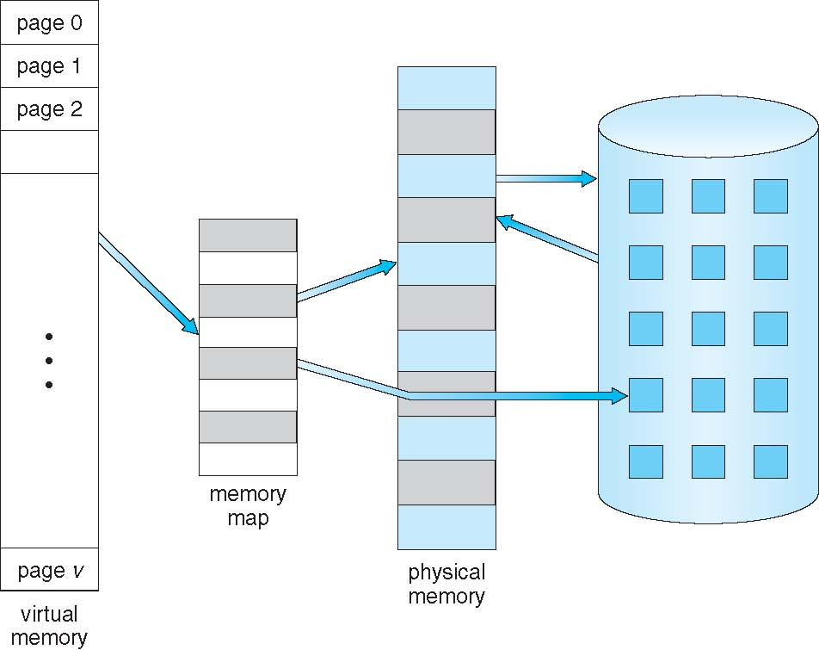
Virtual Memory That is Larger Than Physical Memory

Slide 66

Virtual-address Space
Usually design logical address space for stack to start at Max logical address and grow “down” while heap grows “up”
Maximizes address space use
Unused address space between the two is hole
No physical memory needed until heap or stack grows to a given new page
Enables sparse address spaces with holes left for growth, dynamically linked libraries, etc
System libraries shared via mapping into virtual address space
Shared memory by mapping pages read-write into virtual address space
Pages can be shared during fork(), speeding process creation

Slide 67
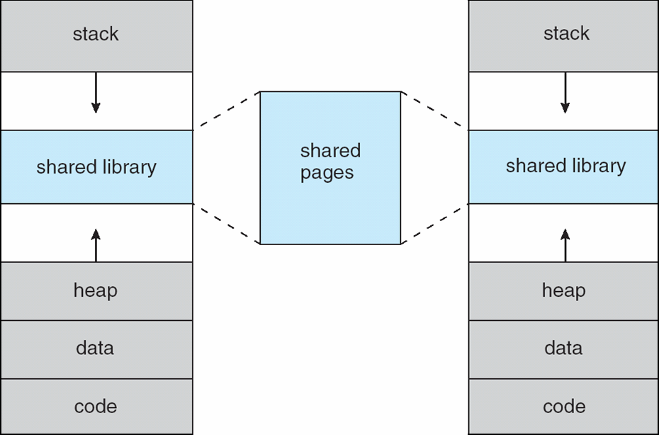
Shared Library Using Virtual Memory

Slide 68

Demand Paging
Could bring entire process into memory at load time
Or bring a page into memory only when it is needed
Less I/O needed, no unnecessary I/O
Less memory needed
Faster response
More users
Similar to paging system with swapping (diagram on right)
Page is needed ⇒ reference to it
invalid reference ⇒ abort
not-in-memory ⇒ bring to memory
Lazy swapper – never swaps a page into memory unless page will be needed
Swapper that deals with pages is a pager

Slide 69
Basic Concepts
With swapping, pager guesses which pages will be used before swapping out again
Instead, pager brings in only those pages into memory
How to determine that set of pages?
Need new MMU functionality to implement demand paging
If pages needed are already memory resident
No difference from non demand-paging
If page needed and not memory resident
Need to detect and load the page into memory from storage
Without changing program behavior
Without programmer needing to change code

Slide 70
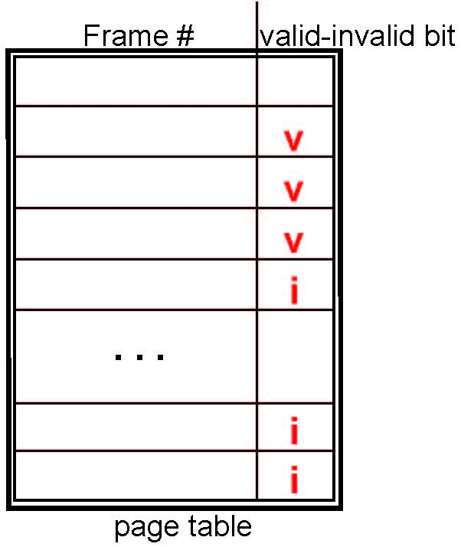
Valid-Invalid Bit
With each page table entry a valid–invalid bit is associated (v ⇒ in-memory – memory resident, i ⇒ not-in-memory)
Initially valid–invalid bit is set to i on all entries
Example of a page table snapshot:
During MMU address translation, if valid–invalid bit in page table entry is i ⇒ page fault

Slide 71
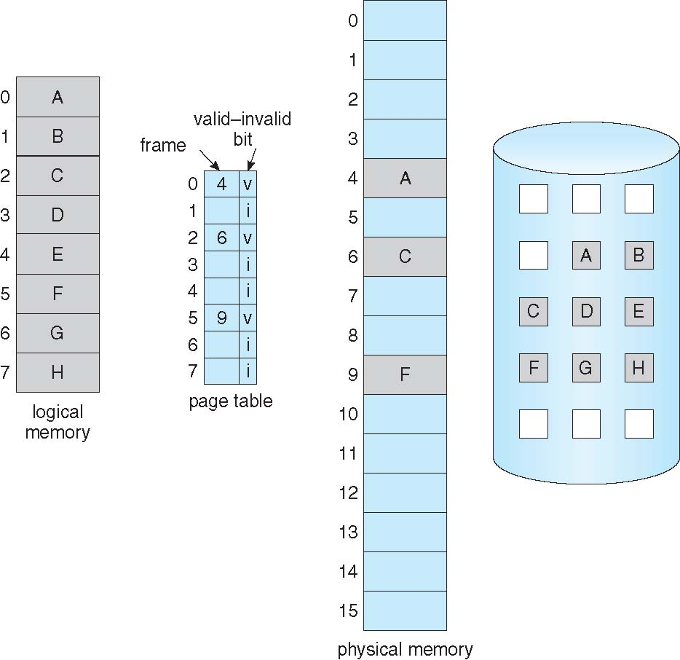
Page Table When Some Pages Are Not in Main Memory

